Slide 1
Object oriented programming (OOP)

Slide 2
Introduction to OOP
Object Oriented Programming (OOP) is a programming technique to create programs based on the real world objects.
The states and behaviours of an object are represented as the member variables and methods.
In object oriented programming the programs are organized around objects and data rather than actions and logic

Slide 3
Introduction to OOP
It is also, an approach used for creating reusable code instead of a redundant one.
The program is divided into self-contained objects or several mini-programs.
Every Individual object represents a different part of the application having its own logic and data to communicate within themselves.

Slide 4
Advantages of OOP over POP
Object-Oriented Programming (OOP) | Procedural-Oriented Programming (POP)
It is a bottom-up approach | It is a top-down approach
Program is divided into objects | Program is divided into functions
Makes use of Access modifiers ‘public’, private’, protected’ | Doesn’t use Access modifiers
It is more secure | It is less secure

Slide 5
OOP Principles
Abstraction: Process of Identifying the essential details to be known and ignoring the non-essential.
Encapsulation: A mechanism of hiding the internal details and allowing a simple interface.
Inheritance: Acquiring the properties from one object to other object (Reusing the properties).
Polymorphism: Ability to take more than one form.
  Method Overloading and Method Overriding.

Slide 6
Class and Object
A class is a prototype or design that describes the common attributes (properties) and activities (behaviour) of the object.
class is an example of Abstraction and Encapsulation
Object is a real world entity. It is instance of a class.
Defining a class does not allocate memory where as creating an object allocates memory.

Slide 7
Creating a Class
Class: Use the class keyword to define a class. The class keyword includes the name of the class and begins an indented block of code where we include the attributes (data) and methods (code).
Syntax:
class <classname>:
Data members = value
…….
Member functions:
……..

Slide 8
Example 1
class PartyAnimal:
def party(self,x) :
print("Method")
an = PartyAnimal()
an.party()
Output:
Method

Slide 9
OOP Terminology
Class variable: A variable that is shared by all instances of a class. Class variables are defined within a class but outside any of the class's methods. Class variables are not used as frequently as instance variables are.
Instance variable: A variable that is defined inside a method and belongs only to the current instance of a class.
Data member: Defines either a class variable or an instance variable used to hold data associated with a class and its objects.

Slide 10
OOP Terminology
Instance: An individual object of a certain class. Example: An object obj that belongs to a class Circle, is an instance of the class Circle.
Instantiation: The creation of an instance of a class.
Method: Defines the term used for functions that are part of a class. Even though function and method essentially define the same element, method is considered more specific because only classes can have methods.

Slide 11
OOP Terminology
Object: Defines a unique instance of a class. The object contains all the methods and properties of the original class. However, the data for each object differs. The storage locations are unique, even if the data is the same.

Slide 12
Self variable
Python self variable is used to bind the instance of the class to the instance method.
We have to explicitly declare it as the first method argument to access the instance variables and methods.
This variable is used only with the instance methods.
Python self variable is not a reserved keyword. But, it’s the best practice and convention to use the variable name as “self” to refer to the instance.

Slide 13
Example 2
class Dog:
#instance method
def bark(self,breed):
print('{} is barking.'.format(breed))
d = Dog() #instantiation
d.bark('Tommy') #Method call
Output:
Tommy is barking

Slide 14
Constructor
A constructor is a special method that is used to initialize the instance variables of a class.
In the constructor, we create the instance variables and initialize them with some starting values.
A constructor is called at the time of creating an instance.

Slide 15
Example 3
class Dog:
def __init__(self): #constructor
self.breed = 'Tommy'
def bark(self):
print('{} is barking.'.format(self.breed))
d = Dog()
d.bark()
Output:
Tommy is barking

Slide 16
Example 4
class Dog:
def __init__(self, breed):
self.breed = breed
def bark(self):
print('{} is barking.'.format(self.breed))
d = Dog('Tommy')
d.bark()
Output:
Tommy is barking

Slide 17
Destructor
Destructor is a method which destructs the object by destroying members of class. This method is executed when ever the object removed from memory.
A destructor is called at the time of destroying an instance.

Slide 18
Example 5
class Dog:
def __init__(self, breed):
self.breed = breed
def bark(self):
print('{} is barking.'.format(self.breed))
def __del__(self):
print("Destructor")
d = Dog('Tommy')
d.bark()
Output:
Tommy is barking
Destructor

Slide 19
Class and Object Variables
Class variables are shared by all objects (instances) of that class.
As there is only one copy of a class variable a change of value of such a variable is reflected in all the other instances as well.
Object variables (also called instance variables). These variables can usually have different values for different objects.
E.g. Two accounts have different account numbers

Slide 20
Example 6:
class Account(object):
counter = 0
def __init__(self, holder, number, balance,credit_line=1500):
Account.counter += 1
self.__Holder = holder
self.__Number = number
self.__Balance = balance
self.__CreditLine = credit_line
def __del__(self):
Account.counter -= 1

Slide 21
>>> Account.counter
0
>>> a1 = Account("Homer Simpson", 2893002, 2325.21)
>>> Account.counter
1
>>> a2 = Account("Fred Flintstone", 2894117, 755.32)
>>> Account.counter
2
>>> a3 = a2
>>> Account.counter
2
>>> a4 = Account("Bill Gates", 2895007, 5234.32)
>>> Account.counter
3
>>> del a4
>>> Account.counter
2
>>> del a3
>>> Account.counter 2
>>> del a2
>>> Account.counter
1

Slide 22
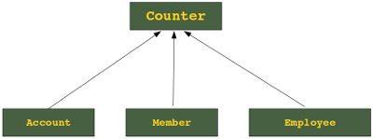
Inheritance
inheriting or transfer of characteristics from parent to child class without any modification”.
The new class is called the derived/child class and the one from which it is derived is called a base/parent class.

Slide 23
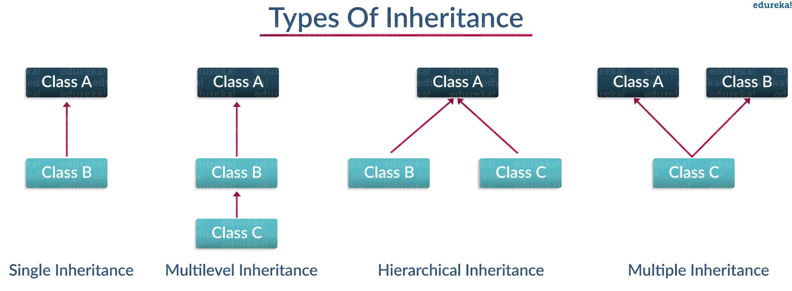

Slide 24
Single Inheritance
class Employee:
def __init__(self, name, age, salary):
self.name = name
self.age = age
self.salary = salary
class PartTime(Employee):
def __init__(self, name, age, salary,iid):
super().__init__(name, age, salary)
self.iid = iid
def empName(self):
print("Employee Name "+self.name)
Em = PartTime('Rajesh',32,23432,43)
Em.empName()

Slide 25
Multilevel Inheritance
class Employee:
def __init__(self, name, age, salary):
self.name = name
self.age = age
self.salary = salary
class PartTime(Employee):
def __init__(self, name, age, salary,iid):
self.name = name
self.age = age
self.salary = salary
self.iid = iid
class Intern(PartTime):
def __init__(self, name, age, salary, iid):
self.name = name
self.age = age
self.salary = salary
self.iid = iid
emp1 = Intern('harshit',22,1000,1)
emp2 = PartTime('arjun',23,2000,2)
print(emp1.age)
print(emp2.age)

Slide 26
Hierarchical Inheritance
class Employee:
def __init__(self, name, age, salary):
self.name = name
self.age = age
self.salary = salary
class PartTime(Employee):
def __init__(self, name, age, salary,iid):
self.name = name
self.age = age
self.salary = salary
self.iid = iid
class FullTime(Employee):
def __init__(self, name, age, salary, iid):
self.name = name
self.age = age
self.salary = salary
self.iid = iid
emp1 = FullTime('harshit',22,1000,1)
emp2 = PartTime('arjun',23,2000,2)
print(emp1.age)
print(emp2.age)

Slide 27
Multiple Inheritance
class employee():
def __init__(self, name, age,):
self.name = name
self.age = age
class payslip():
def __init__(self,da,age,salary):
self.da = da
self.hra = hra
self.salary = salary
class emp_pay(employee,payslip):
def __init__(self, name, age, salary,da,hra):
self.name = name
self.age = age
self.salary = salary
self.da = da
self.hra=hra
emp2 = emp_pay('arjun',23,2000,200,200)
print(emp2.age)
print(emp2.salary)

Slide 28
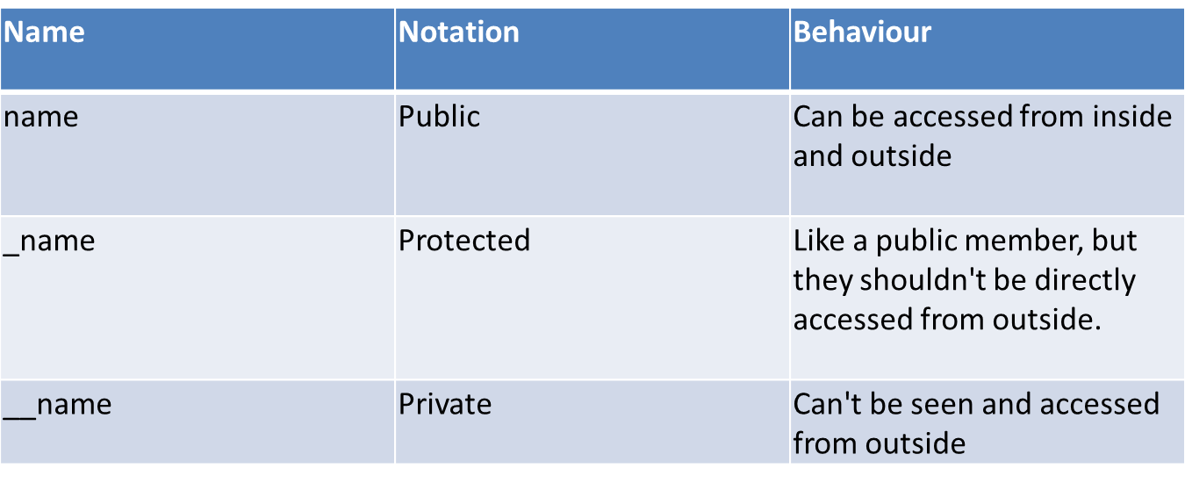
Data Encapsulation
Data hiding is possible by Encapsulation
Using Access Specifier we can have data hiding

Slide 29
Example:
class exam(object):
def __init__(self, a, b, c):
self.p = a # public member
self._pr = b # Protected member
self.__prt = c #Private member
>>> x = exam(11,13,17)
>>> x.p
11
>>> x._pr
13
>>> x._pr= 23
>>> x._pr
23
>>> x.__prt
Traceback (most recent call last): File "<stdin>", line 1, in <module> AttributeError: ‘exam' object has no attribute '__prt'

Slide 30
Types of methods
We can classify the methods in the following
3 types:
  Instance methods
    Accessor methods
    Mutator methods generally used for initializing the private members of a class
  Class methods
  Static methods

Slide 31
Instance methods types
  Accessor methods simply access of read data of the variables. They do not modify the data in the variables. Accessor methods are generally written in the form of getXXXX( ) and hence they are also called getter methods.
  Mutator methods are the methods which not only read the data but also modify them. They are written in the form of setXXXX( ) and hence they are also called setter methods.

Slide 32
Instance Method Example
class Student:
def setName(self,n):
self.__name = n
def setBranch(self,b):
self.__branch = b
def getName(self):
return self.__name
def getBranch(self):
return self.__branch
s=Student()
s.setName('Alex')
s.setBranch('CSE')
print s.getName()
print s.getBranch()

Slide 33
Class Method
class Dog:
@classmethod
def walk(cls):
print('Dog is Walking')
Dog.walk()
Output:
Dog is Walking

Slide 34
Static Method
class Dog:
def __init__(self, breed):
self.breed = breed
@classmethod
def walk(cls):
print('Dog is Walking')
# instance method
def bark(self):
print('{} is barking.'.format(self.breed))
@staticmethod
def add(x, y):
return x + y
Dog.walk()
d = Dog('Tommy')
d.bark()
print(Dog.add(10, 20))

Slide 35
Static Method
Output:
Dog is Walking
Tommy is barking.
30

Slide 36
Method Overriding
Syntax:
class Subclass(BaseClass):
  <class body>
The super( ) method:
super().init() # call super class constructor
super().init(arguments) # call super class constructor and pass arguments
super().method() # call super class method

